Slide 1


RWANDA TVET BOARD
THE ESTABLISHMENT OF TECHNICAL SCHOOLS’ PRODUCTION UNITES, COMPANIES & BUSINESS INCUBATION CENTERS.
24th March ,2023
RTB - Employable Skills for Sustainable Job Creation - RTB

Slide 2
OUTLINE
PRODUCTION UNIT & SCHOOL COMPANY
Background on income-generating activities in TVET Schools
Rationale
Policies and Strategies linked to Income generating activities within Technical Schools
Technical School Production Unit vs Technical School Company
Functions of the management of the production unit
Organizational structure of the production unit
Technical School Company
Criteria for the school company to be incorporated
Financial and Material resources
Monitoring and evaluation
RTB - Employable Skills for Sustainable Job Creation - RTB

Slide 3


OUTLINE CONT.
BUSINESS INCUBATION CENTER
Purpose
Types of Business incubation centers
Incubation process
Selection process
Legal status of BIC
Organizational structure of the incubation
BIC financial model
RTB - Employable Skills for Sustainable Job Creation - RTB

Slide 4
BACKGROUND OF INCOME-GENERATING ACTIVITIES IN TVET SCHOOLS
The Government cannot remain the only source of fund of Technical schools
A considerable budget is needed because TVET is very expensive
Engagement in income-generating activities is a way in which TVET institutions can contribute to their funding needs
Trainees actively participate in income generating activities, through the learn-by-doing principle
RTB - Employable Skills for Sustainable Job Creation - RTB

Slide 5
RATIONALE
To make Heavy investments in Technical schools in terms of construction , training equipment, training consumables, etc. more productive
To address the existing budget gaps in Technical Schools, these Technical Schools have to set internal revenue generation mechanisms, using available resources and expertise.
To request Technical schools to establish Production Units and competent Institutions to facilitate the Registration of Technical Schools’ Private companies
There’s a need for effective management strategies for generated revenue
RTB - Employable Skills for Sustainable Job Creation - RTB

Slide 6
  POLICIES AND STRATEGIES LINKED TO INCOME GENERATING ACTIVITIES WITHIN TVET SCHOOLS
7Years government program: National Strategy for Transformation (NST1)
National skills development and employment promotion strategy 2019 - 2024
Education sector strategic plan 2018/19 to 2023/24
TVET POLICY: Sustainable Innovative financing mechanisms in TVET
RTB - Employable Skills for Sustainable Job Creation - RTB

Slide 7
  PRODUCTION UNIT vs TECHNICAL SCHOOL COMPANY
Production Unit | Company
A production unit is set up for the sales of products made while ensuring students' acquisition of practical skills, and attitudes of production in line with their area of specialization Starting a school production unit does not require additional investments. The available resources namely teachers, students, and workshops are sufficient for setting up a production unit Production unit is a necessity in every Technical school | Technical school’s company is a company like any other company registered in RDB The shareholder in each of these companies is the Technical school itself with 100% shares The annual turnover for the existing production unit should be at least equivalent to 20,000,000 RWF Technical school should have adequate resources
RTB - Employable Skills for Sustainable Job Creation - RTB

Slide 8
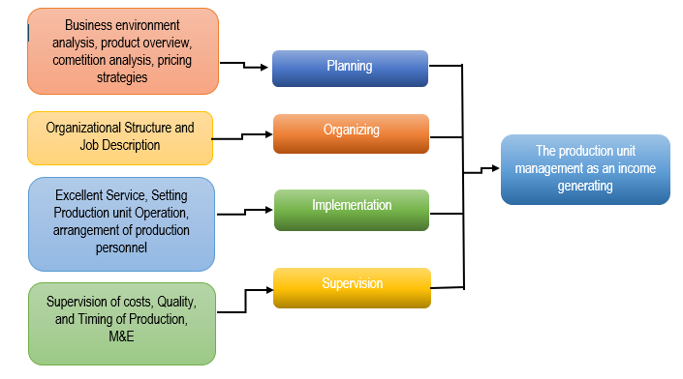
FUNCTIONS OF THE MANAGEMENT OF TECHNICAL SCHOOL PRODUCTION UNIT
RTB - Employable Skills for Sustainable Job Creation - RTB

Slide 9
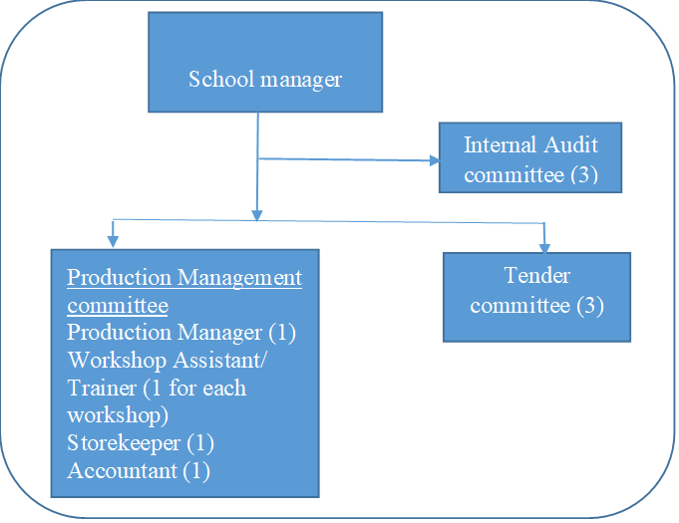
PRODUCTION UNIT ORGANIZATIONAL STRUCTURE
Production unit management committee: Should be composed of a Production manager, Trainer responsible of the workshop (one for each workshop) and a storekeeper and or an accountant. This committee is responsible for regular inventory control and keeping records, and all report to the school manager.
Tender committee: Should be composed of at least three members designated by the school manager in collaboration with the parents’ committee.
Internal Audit committee: This committee will objectively assess the production unit processes; assess the production unit risks and the efficacy of its risk management efforts; Ensure that the production unit is complying with relevant laws and statutes and Evaluate internal control and make recommendations on how to improve.
RTB - Employable Skills for Sustainable Job Creation - RTB

Slide 10
HUMAN RESOURCES AND THEIR RESPONSIBILITIES
School head teacher: is the coordinator of the production unit, and ensures conflict management and capacity building of the production unit staff.
Production manager: to ensure daily production, and quality of the products and support the accountant in the costing of final products.
Workshop assistant/ storekeeper: ensures availability of consumables (stock movement), tools, equipment, facilitates students’ practical work, and storage of finished products with their inventory.
Accountant: Verify and submit prepared material list request for product and submit it to tender committee. Selling of final products and maintain clean bookkeeping of the production unit.
Students and their teachers: learn-by-doing
RTB - Employable Skills for Sustainable Job Creation - RTB

Slide 11
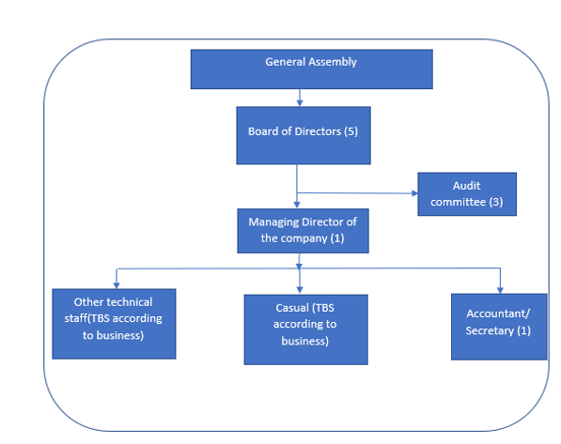
TECHNICAL SCHOOL’S COMPANY
Company’s organizational structure
School General Assembly
Board of Directors
Managing Director of the company
Internal Audit committee
Technical Staff
Casual workers
Accountant
RTB - Employable Skills for Sustainable Job Creation - RTB

Slide 12
CRITERIA FOR A COMPANY TO BE INCORPORATED/ REGISTERED
Accreditation letter for the school
Authorization of competent authority to establish the Technical School Company
The school must have a working production unit.
The annual turnover for the existing production unit should be at least equivalent to 20,000,000 RWF
A business plan for the Company.
Enough equipment for the company to work without interrupting the teaching and learning process.
School general assembly meeting resolution for the establishment of a company, managerial organs, and board of directors and other company's legal incorporation details such as:
Name of the company
Shareholders
Number of shares
Value of each share
Address of the company
Business activities
RTB - Employable Skills for Sustainable Job Creation - RTB

Slide 13
FINANCIAL AND MATERIAL RESOURCES
Shares
Revenues from business operations
Loans and grants
Proceeds from sales on own assets
Other revenues prescribed by the law
The board of Directors will establish the financial management guideline that provides guidance over the company's resources management and generated income
RTB - Employable Skills for Sustainable Job Creation - RTB

Slide 14
MONITORING AND EVALUATION
The Monitoring and evaluation of the Technical School production unit and the company will focus on:
• The business plan;
• The strategic plan;
• The action plan; and
• Annual budget
RTB to take appropriate actions when expectations are not met.
RTB - Employable Skills for Sustainable Job Creation - RTB

Slide 15
RWANDA TVET BOARD
THE ESTABLISHMENT AND OPERATIONALIZATION OF BUSINESS INCUBATION CENTERS IN TECHNICAL SCHOOLS (TSS&VTC)
RTB - Employable Skills for Sustainable Job Creation - RTB

Slide 16
WHAT IS THE PURPOSE?
Support innovative students to build and commercialize their innovative ideas and help those who lack minimum supportive facilities to start their own business.
Enhance Entrepreneurship Development skills
RTB - Employable Skills for Sustainable Job Creation - RTB

Slide 17
  INCUBATOR/ BUSINESS INCUBATION CENTRE (BIC)
A Business Incubation Centre or “Incubator” is a company that helps new and start-up companies to develop by providing services such as management training or office space. It is also defined as a catalyst tool for either regional or national economic development.
SCHOOL-BASED-BIC | STAND ALONE BIC
A Business Incubation Centre within and under a Technical School [attached to the existing school facilities: (Workshops and Trainers). It mainly provides services to graduates, upon request. | A Business Incubation Centre NOT attached to a School [a stand-alone centre/facility]. It mainly provides services to both graduates and non-graduates from the labour market, upon request

Slide 18
  Technical School Linked BICs
A Technical School linked BIC operates under an accredited Technical School. The BIC will have an office within the school and managed by one of the school staff but the later may vary depending on the trades within the school. The managing team includes:
- The Entrepreneurship trainer,
- Technical Staff
- Career Guidance Advisor
- Liaison Officer
RTB - Employable Skills for Sustainable Job Creation - RTB

Slide 19
  Stand-alone BICs
For a stand-alone BIC to start its operation, it must fulfill the following requirements:
  Adequate infrastructure
  Machinery tools and equipment related to services offered
  Registration of the services offered in a competent institution
  RTB Recruitment of competent/qualified staff
  Availability of Resources of start-up cost
  Set the guidelines for the quality of the services offered referring to national policy of standardization
RTB - Employable Skills for Sustainable Job Creation - RTB

Slide 20
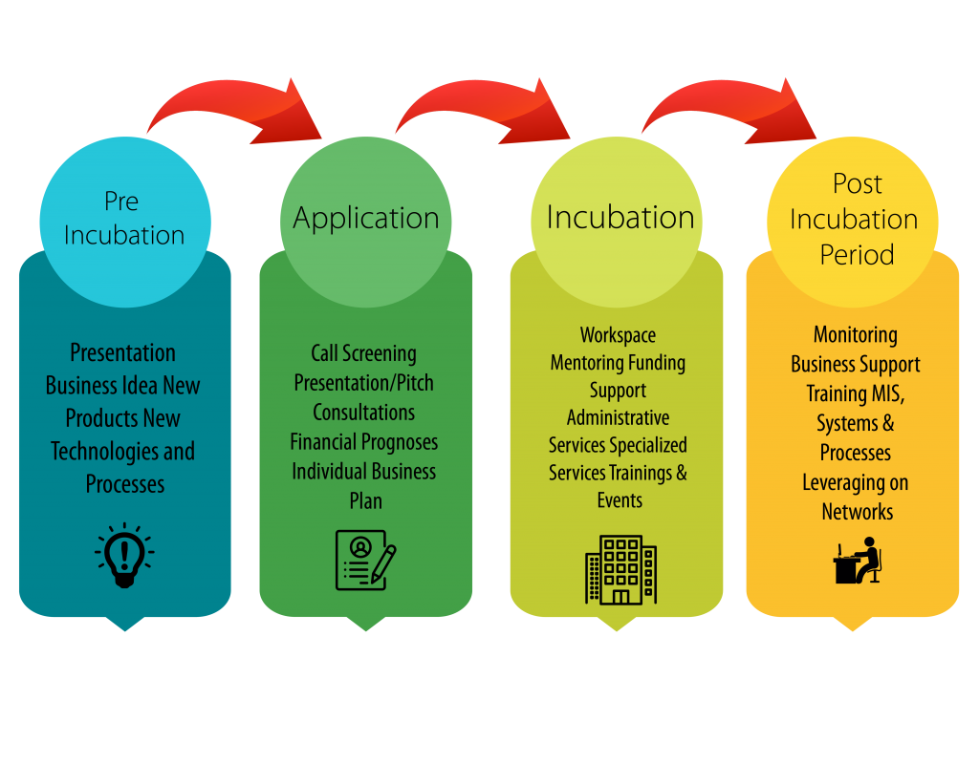
  INCUBATION PROCESS
RTB - Employable Skills for Sustainable Job Creation - RTB

Slide 21
  INCUBATION PROCESS CONT.
Pre- Incubation activities :
Interactive sessions with potential entrepreneurs.
Entrepreneurial Assessment and feedback session
Counselling and pre-incubation business advice
Business start-up guidance
Application :
Submission of Business Idea by filling application form
Business Idea Presentation / Pitch before selection Committee
Question and Answers Session
Business Idea selection
RTB - Employable Skills for Sustainable Job Creation - RTB

Slide 22
  INCUBATION PROCESS CONT.
Incubation activities :
SCHOOLS-BIC offer office space, high speed internet, meeting rooms and other business development support services.
Training and Mentoring
Networking with Industry experts
Efficient utilization of provided resources
New Product/Process Development
Incubated Companies Performance Evaluation
Post Incubation Period activities :
Business and Growth Assessment
Clients Assessment
Financial Evaluation
Graduation Program
RTB - Employable Skills for Sustainable Job Creation - RTB

Slide 23
  LEGAL IDENTITY /STATUS OF AN INCUBATOR
The legal status of one BIC could take the form of a private body, a public body, or a mix public and private organization.
The Technical schools’ linked Incubators will be operating as non-profit making entities.
Business Incubation as a stand-alone unit must be registered in RTB and bear the registration certificate as a stand alone BIC.
School linked BIC is under TVET school as an institution that is accredited by a competent organ. Therefore no need of being registered in RTB
RTB - Employable Skills for Sustainable Job Creation - RTB

Slide 24
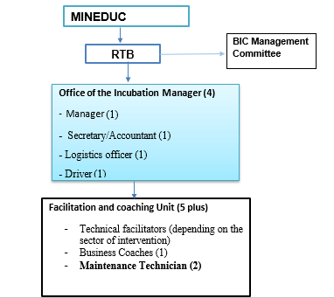
  Organizational Structure of The Incubator
For a Technical school linked Incubation center to be well functional a staff in charge of incubation and career guidance services can be helpful once available on the structure of Schools
RTB - Employable Skills for Sustainable Job Creation - RTB

Slide 25
  BIC FINANCING MODEL
Public funding
Private funding
National and regional public
bodies which fund the core
activities of the BIC (subsidies)
Income from client SMEs and
entrepreneurs
Funding coming from programme
and Project Implemented by the
BIC for the public authorities
Income from housing and incubator
services
Private sponsorship (e.g large
Companies Interested in spin off
process,….)
International Donors
RTB - Employable Skills for Sustainable Job Creation - RTB

Slide 26
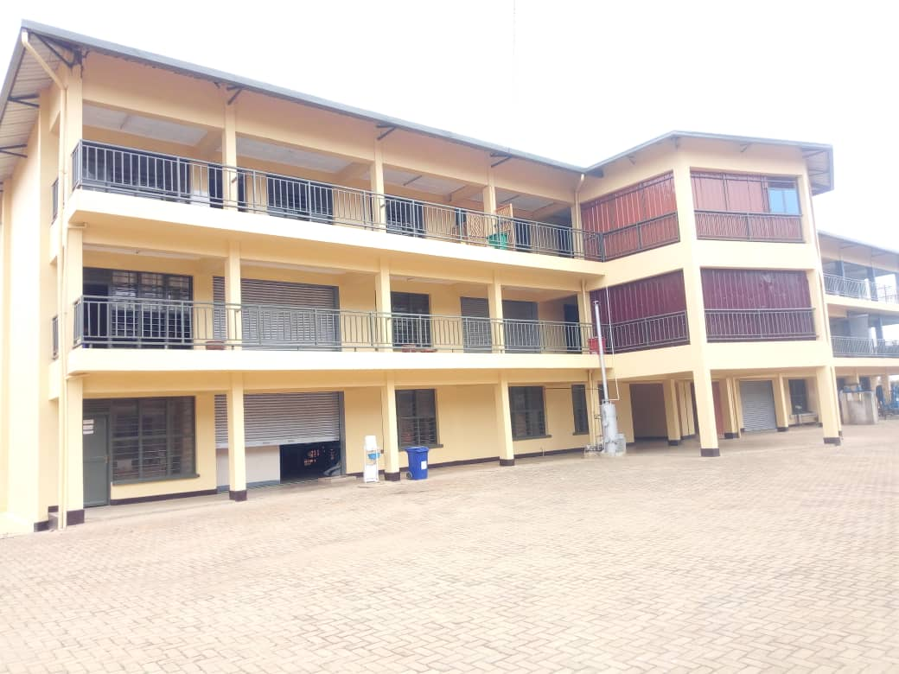
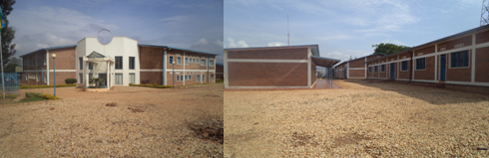
  Existing BICs
Nyarutarama Business Incubation center
Masaka Business Incubation Center
Kavumu TSS Business Incubation center
RTB - Employable Skills for Sustainable Job Creation - RTB

Slide 27
  WAY FORWARD
All TVET schools should establish a Production unit well structured and well managed
TVET schools which production unit turnover hits 20 million should create a company
At least TSSs should establish the Business incubation centers to help Students with innovation ideas
RTB - Employable Skills for Sustainable Job Creation - RTB

Slide 28
Thank You!
RTB - Employable Skills for Sustainable Job Creation - RTB

